Slide 1
ONLINE DOCTOR APPOINTMENT
By
ROSHAN (2010030441)
HARSHA VARDHAN (2010030173)
SIDDHARATH (2010030475)
SAI BHARGAV (2010030535)
Review 3
MENTOR’S
MR SAISDHAR, Mr. G. Madhukar Rao

Slide 2
ABSTRACT
The purpose of Doctor Appointment System is to automate the existing manual system by the help of computerized equipments and full-fledged computer software, fulfilling their requirements, so that their valuable data/information can be stored for a longer period with easy accessing and manipulation of the same. The required software and hardware are easily available and easy to work wit

Slide 3
Tools
Operating System : windows 10,11 later
Web Server : Tomcat version 10
Database server : My SQL ,Access
Runtime Environment :Java Runtime Environment 5.0
Development tools: Eclipse,Intellji idea
Web Browser : chrome,edge,firefox,brave

Slide 4
Work Progress
Harsha Vardhan – working with back end (my sqL)and other boot techniques
Roshan – working on html and jsp
Siddharth – working on java and servelts
Bhargav - working on java and servelts

Slide 5

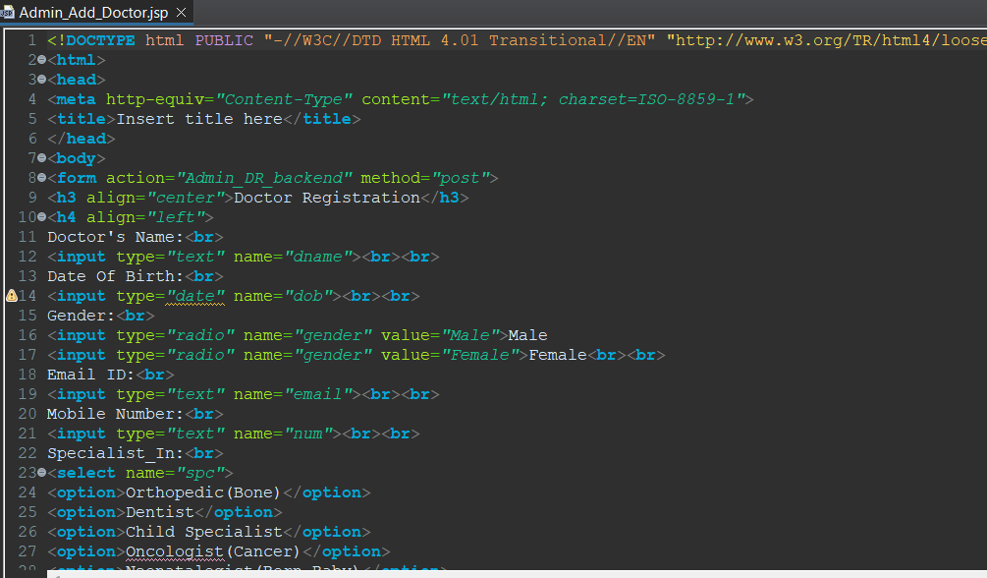
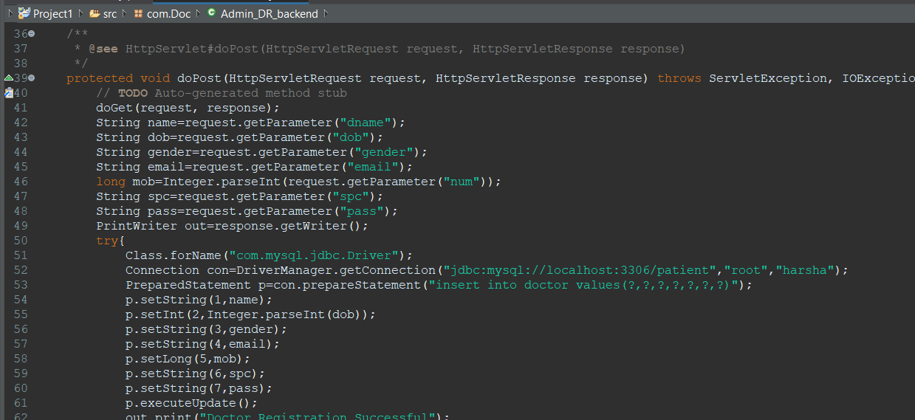
Code –

Slide 6
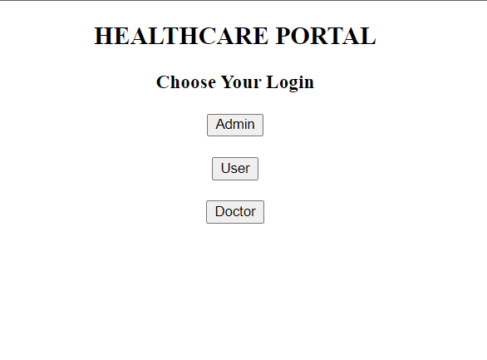
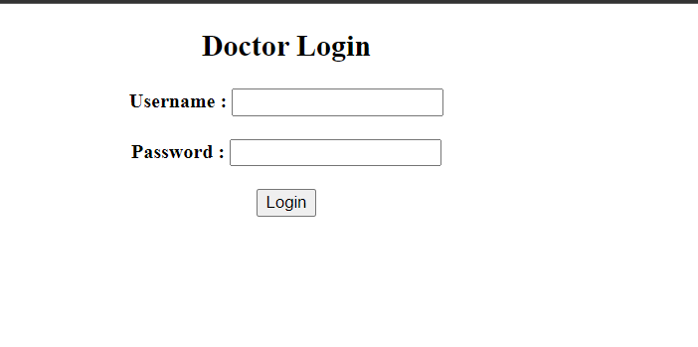
Beta Test output--

Slide 7
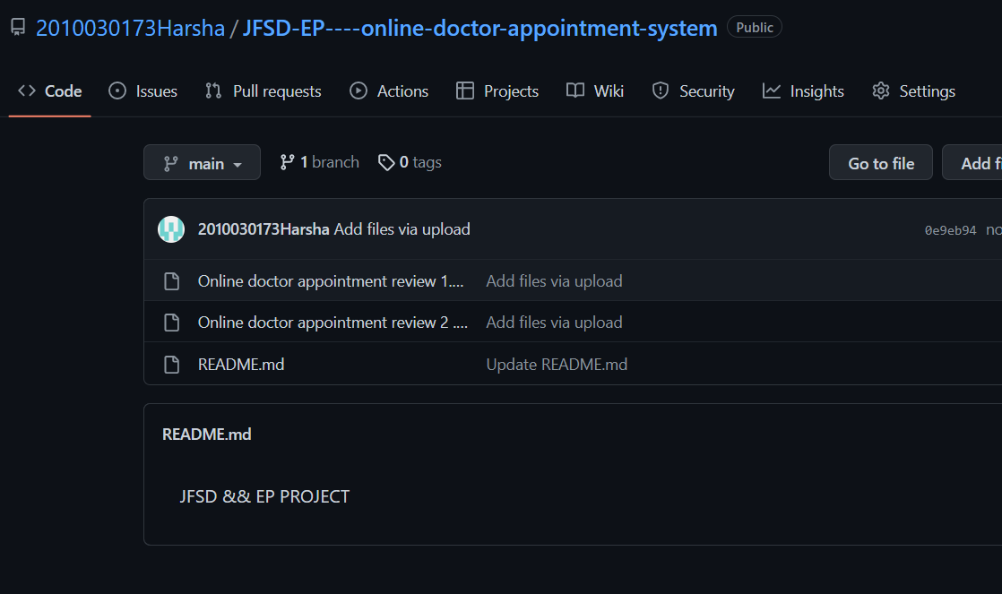
Github Commits--

Slide 8
Conclusion
We want to conclude our project by saying with the help of our project we
can easily book our test slots through online which saves lot time and
energy instead of standing in long queues.Also it helps lab technician to
organize and manage records and consult doctor

Slide 9
REFERENCES
https://www.primescholars.com/articles/literature-review-on-appointment-scheduling-in-hospitals-management.pdf
https://www.ncbi.nlm.nih.gov/pmc/articles/PMC5425771/
https://www.ijera.com/papers/vol12no4/Ser-3/I1204034852.pdf

Slide 10

THANK YOU

